Slide 1
Scalars and Vectors

Slide 2
Scalars and Vectors
Scalar-
A quantity described completely by its size, which is also called its magnitude.
Think of a scalar as just a number that may or may not have units.
Vector-
A quantity that has both magnitude and direction.
Think of a vector as the combination of a scalar quantity and direction.

Slide 3
Scalars and Vectors
A common way to represent direction is with a “hat” notation.
  For example: means, “in the positive x direction”.
A common way to represent a vector is with an arrow above the variable.
  For example: means “vector A”.

Slide 4

Scalars and Vectors

Slide 5
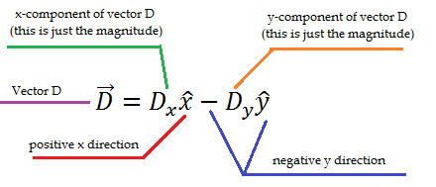
Scalars and Vectors

Slide 6
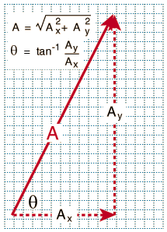
Scalars and Vectors
On a graph, a vector is usually represented as an arrow, it’s length being the magnitude and where it’s pointing is the direction.
These formulas relate the components to the vector.
They allow you to calculate the magnitude and direction of the vector if the components are known.

Slide 7
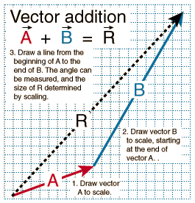
Scalars and Vectors

Slide 8
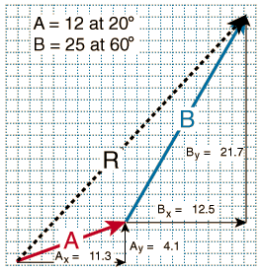


Scalars and Vectors

Slide 9
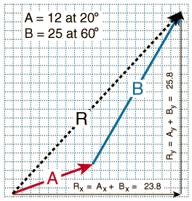
Scalars and Vectors

Slide 10
Scalar Vector Example
Vector A has a magnitude of 19m and is parallel to the x-axis.
Vector B has a magnitude of 14m and is at a 130º angle with respect to the x axis.
Vector C has a magnitude of 9m and is at a 75º angle with respect to the x axis.
What is the magnitude and direction of the resultant vector R?

Slide 11
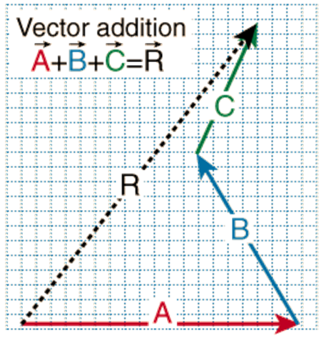
Scalar Vector Example

Slide 12







Scalar Vector Example
First, we’ll solve for the magnitude of vector R.

Slide 13
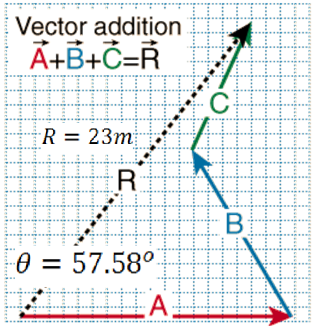



Scalar Vector Example
Now we’ll solve for the angle, which indicated the direction portion of vector R.

Slide 14
Scalars and Vectors
To subtract vectors, just change the sign of every term in the vector you are subtracting, and then add them.

Slide 15
Scalars and Vectors
There is only one way to multiply scalars by scalars, the familiar way.
When you multiple a scalar by a vector, you get a vector.
However, there are two different ways to multiply vectors by vectors:
  The dot product, which yields a scalar.
  The cross product, which yields a vector.

Slide 16
The Dot Product
The dot product always results in a scalar quantity.
The dot product is also known as the “inner product” for it lets us know how much of one vector can be projected on the other.
A larger dot product means there’s a smaller angle between the vectors.
A dot product of zero means the vectors must be perpendicular to each other.

Slide 17
The Cross Product
A cross product always results in a vector quantity.
The cross product allows you to find a third vector that is orthogonal to the original two vectors.

Slide 18







Vector Multiplication Example

Slide 19







Vector Multiplication Example

