Slide 1
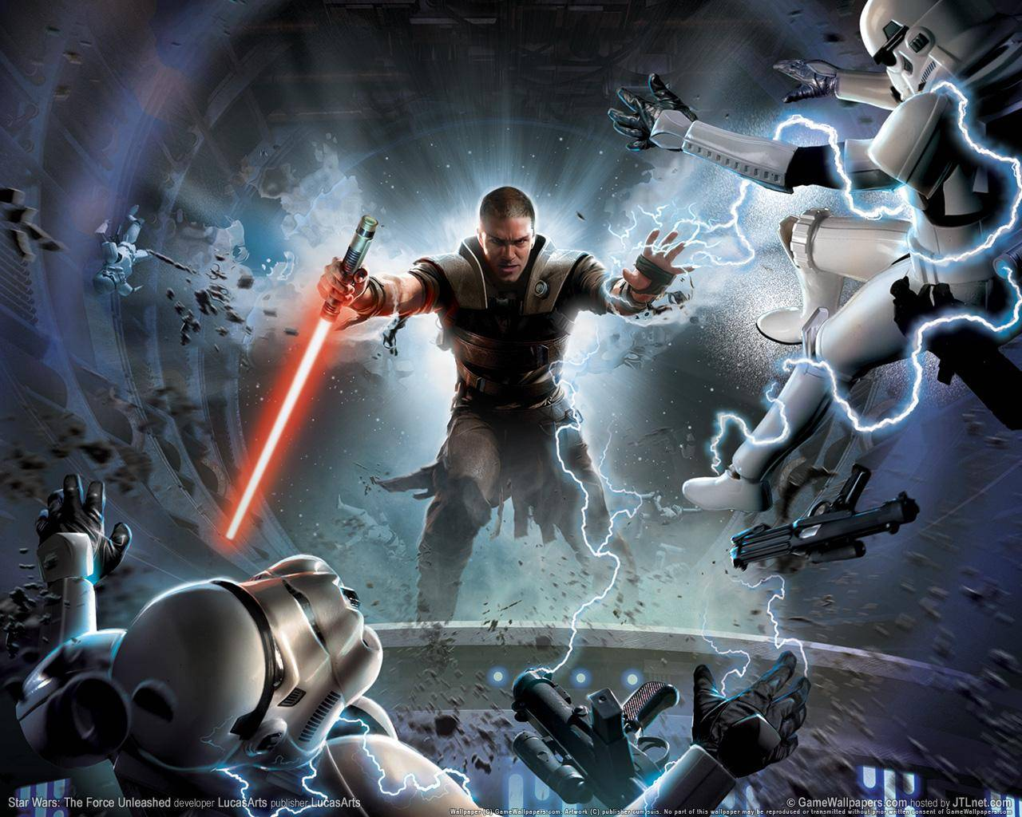
Dynamics
The Study of Force

Slide 2
Force.
(What is it?)

Slide 3
Force is…
…the cause of a
change in motion.
It can also be thought of as a push or pull.

Slide 4
Fundamental Forces
Gravity
Electromagnetic
Weak Nuclear
Strong Nuclear

Slide 5
Fundamental Forces
Gravity – A force exerted by the warping of a portion of the space-time continuum known as the Higgs Field on closed volumes.
This is the definition we’ll be using:
Gravity is the attractive force between objects with mass.

Slide 6
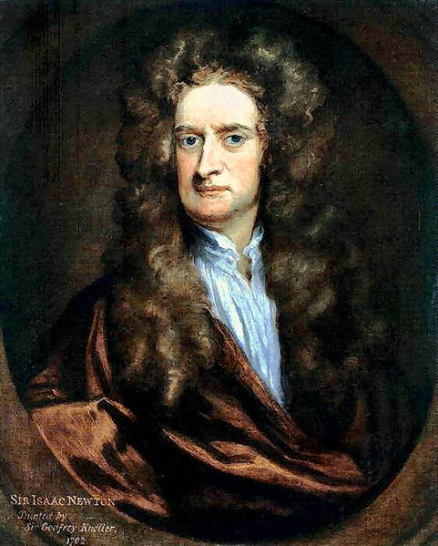
1687
Philosophiæ Naturalis Principia Mathematica
Sir Isaac Newton

Slide 7
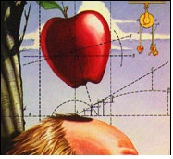

Slide 8

Mass vs. Weight
Mass - How much matter something is made up of.
  In equations: m
  Metric unit: kg (kilogram)
Weight - The strength of the gravitational force being exerted on you by the largest mass within proximity (Earth).
  In equations: F_{g} or W
  Metric unit: N (Newton)

Slide 9

Mass vs. Weight
Acceleration due to gravity- The acceleration an object experiences when near a very massive celestial body such as a planet.
  In Equations: g
  Metric Unit: m/s²
This value applies to Earth only.
g has a different value when near different celestial objects or when changing elevation.

Slide 10

Mass vs. Weight
It’s possible to be massive, yet have no weight.
However, it is not possible to have a large weight, and yet be massless.
This shows how the Newton can be broken down into units derived directly from nature:

Slide 11
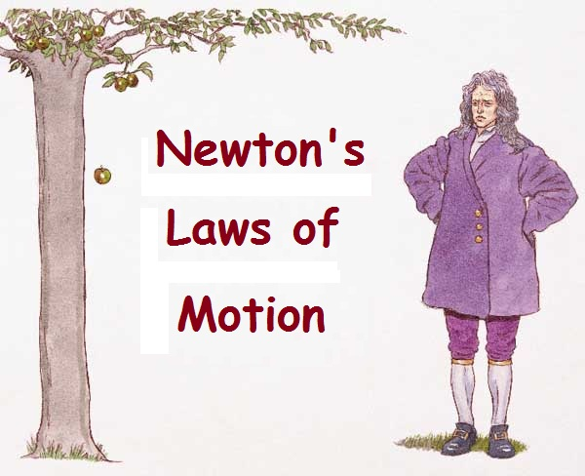

Slide 12
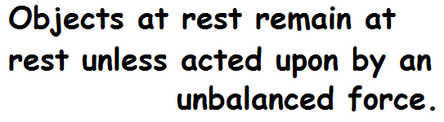
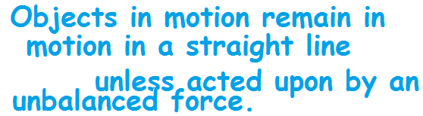
Newton’s 1st Law
(Law of Inertia)

Slide 13
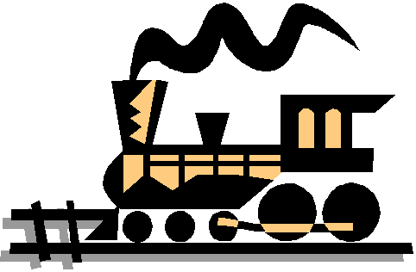
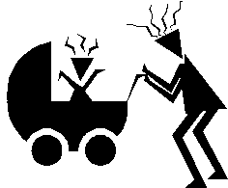
A lot of inertia! The large train resists changing its motion.
Since the train is so huge, it is difficult to change its speed. In fact, a large net force is required to change its speed or direction.
Very little inertia. The small baby carriage has very little resistance to changes in motion.
Since the baby carriage is so small, it is very easy to change its speed or direction. A small net force is required to change its speed or direction.

Slide 14

Inertia
Inertia - A property of matter that corresponds to an objects tendency to resist any change in its motion.
Normal Force – The force perpendicular to the surface of contact.
  In equations: F_{N}
  Metric unit: N

Slide 15
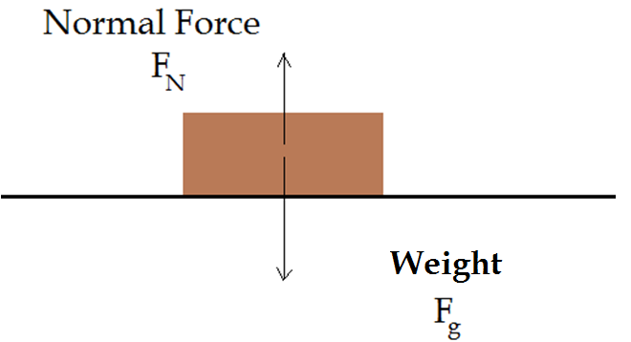
Free-Body Diagram

Slide 16
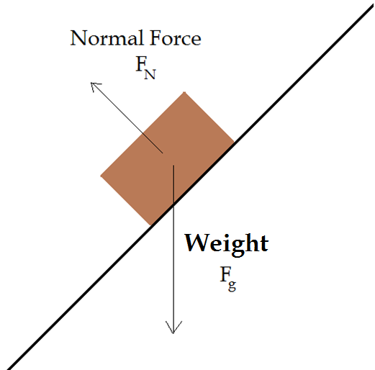
Free-Body Diagram

Slide 17
Newton’s 2nd Law
In the presence of an unbalanced force,
an object experiences
acceleration.

Slide 18


Newton’s 2nd Law

Slide 19
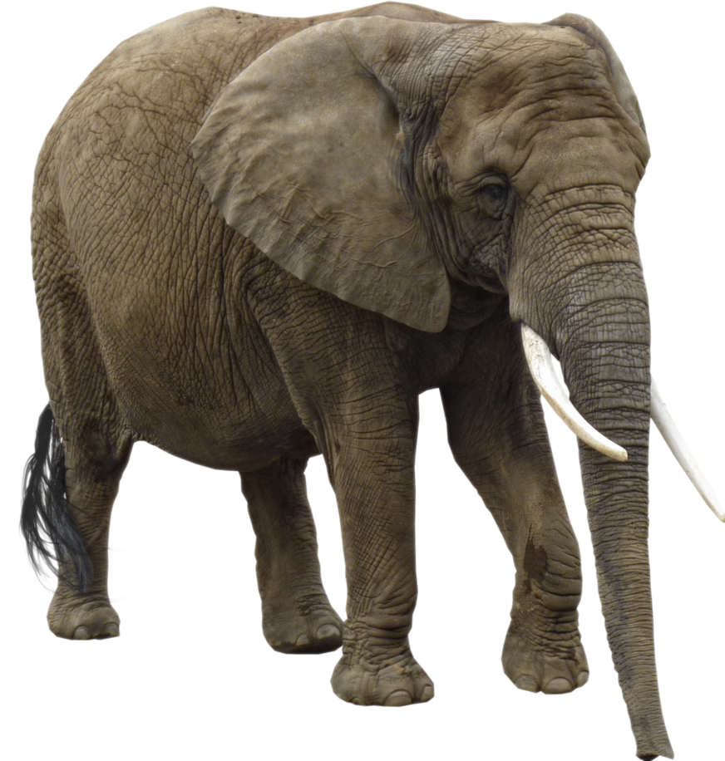
Weight Example
An elephant experiences a gravitational force of 49kN.
How much does the elephant weigh?
How massive is the elephant?

Slide 20
Weight Example
Since the gravitational force the elephant feels is the weight:
F_{g} = 4.9x10⁴ N
Now, we’ll use are weight and mass relationship equation to solve for the mass:
F_{g} = mg
m = F_{g} /g = (4.9x10⁴ N)/(9.8m/s²)
m = 5000kg = 5x10³kg

Slide 21
Rules for drawing a
Free-Body Diagram
All forces acting on the object of interest must be represented in the drawing with arrows.
Forces acting on other objects must not be represented.
All vectors point outward from the origin.
Vectors that are not parallel with the axes must be broken into x and y components.

Slide 22


Rules for applying algebra
∑F_{x} = ma_{x} = your vectors parallel to the x axis
∑F_{y} = ma_{y} = your vectors parallel to the y axis
F_{g} = mg, where g = 9.8m/s²

Slide 23
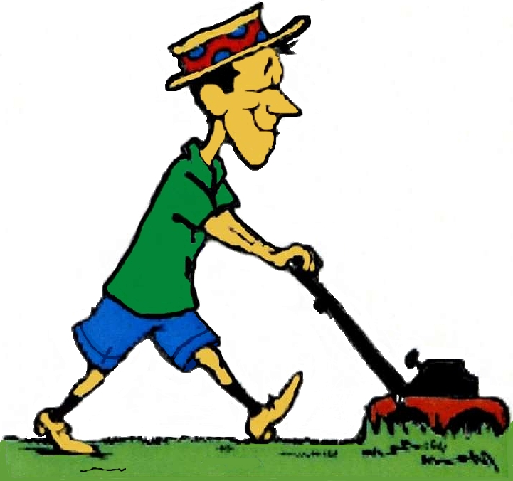
Free Body Diagram Example
Fred pushes a lawnmower at a 60º angle to the ground with a force of 2.2N, and the lawnmower accelerates at a rate of 3cm/s².
What is the mass of the lawnmower?

Slide 24
Free Body Diagram Example
Fred pushes a lawnmower at a 60º angle to the ground with a force of 2.2N, and the lawnmower accelerates at a rate of 3cm/s².
Set up a free body diagram to represent the forces acting on the lawnmower.
How many whole forces are acting on the lawnmower? (Think, how many are in the x direction, how many are in the y direction, and how many are diagonal?)
How many component forces are acting on the lawnmower? (Think, how many are in the x direction, and how many are in the y direction?)

Slide 25
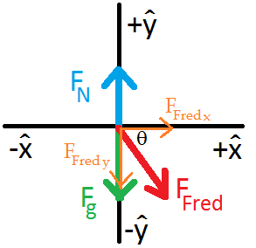
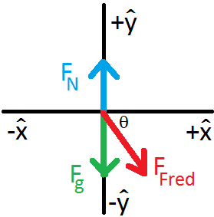
Free Body Diagram Example
There are three whole forces acting on the lawnmower.
  Zero in the x direction, two in the y direction, and one diagonal force vector.
There are two component force vectors acting on the lawnmower.
  One in the x direction and one in the y direction.

Slide 26


Free Body Diagram Example
Now describe the dynamics acting on the lawnmower mathematically.
Finally, solve for the mass of the lawnmower.

Slide 27
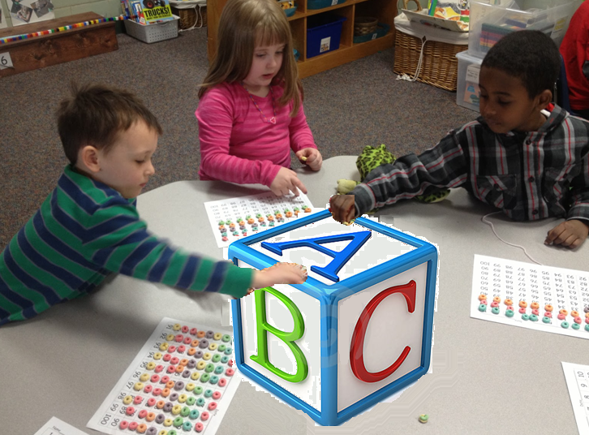
Force Example
What is the acceleration of the block?
What is the normal force exerted on the block by the table?
A 6kg block is acted on by two children pushing diagonally downward.

Slide 28
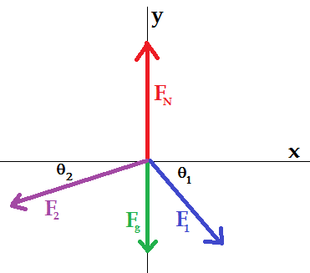
Force Example
The force exerted on the block by the first child is 13N, and the force exerted by the second child is 11N.
Angle 1 is 60º, and angle 2 is 30º .
First we need to draw a free-body diagram.

Slide 29










Force Example
Now let’s put together our sum of the forces equations using the information from our free-body drawing.

Slide 30


Vector force example
There is a particle moving along with a constant velocity of :
Two forces are being applied on the particle, one of which is:
What is the second force?
(Have your answer in vector notation.)

Slide 31



Vector force example
Since the velocity is constant, the acceleration equals zero.

